Slide 1
SARS-CoV-2 omicron variant modelling
Interim Progress Report 14/12/21
University of Edinburgh
Bram van Bunnik
Alex Morgan
Mark Woolhouse
Follows draft briefing notes 01/12/21 and 08/12/21

Slide 2
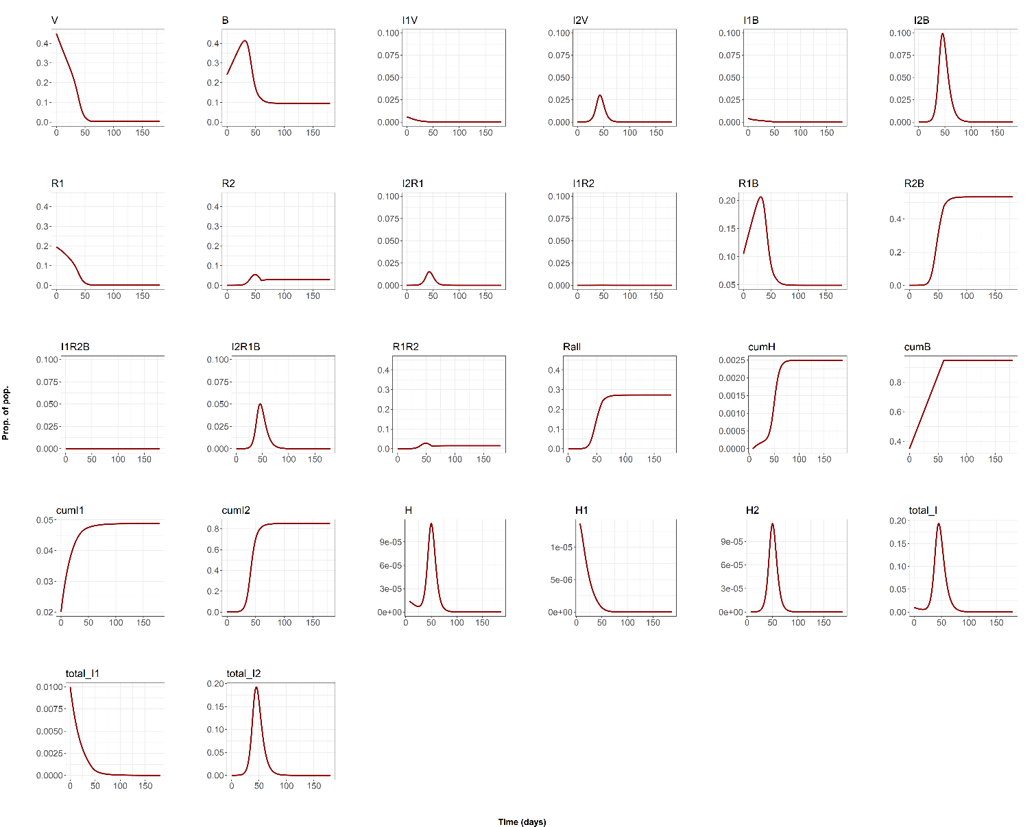
Baseline scenario
Peak I
15-20%
Attack rate >80%
Peak H
>7x higher
Dt = 3 days + only difference between variants is 1.6x higher omicron transmissibility (R_delta=0.99)
Boosters give near complete protection against hospitalisation.

Slide 3
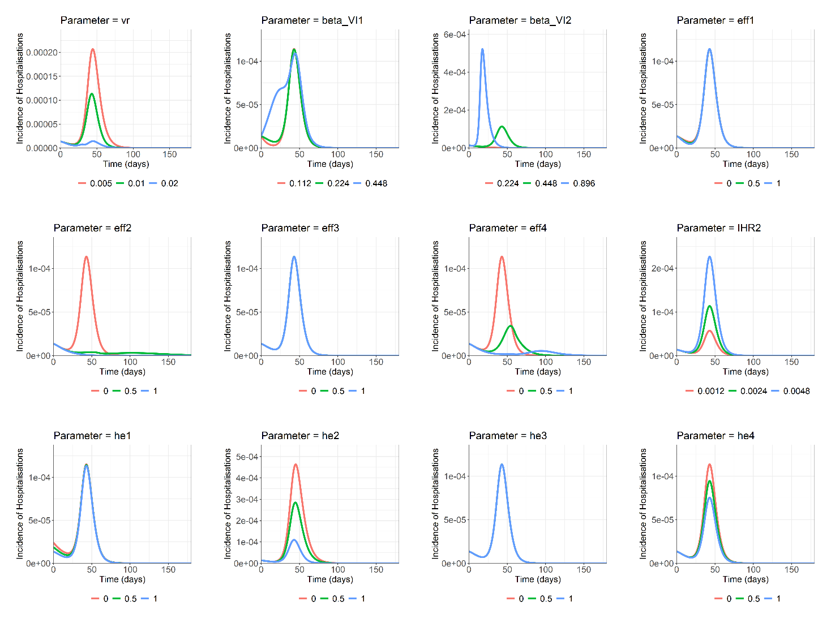
Univariate sensitivity analysis
Parameters setting omicron transmission rates
Parameters setting omicron pathogenicity
Parameter setting vaccine roll-out rate

Slide 4
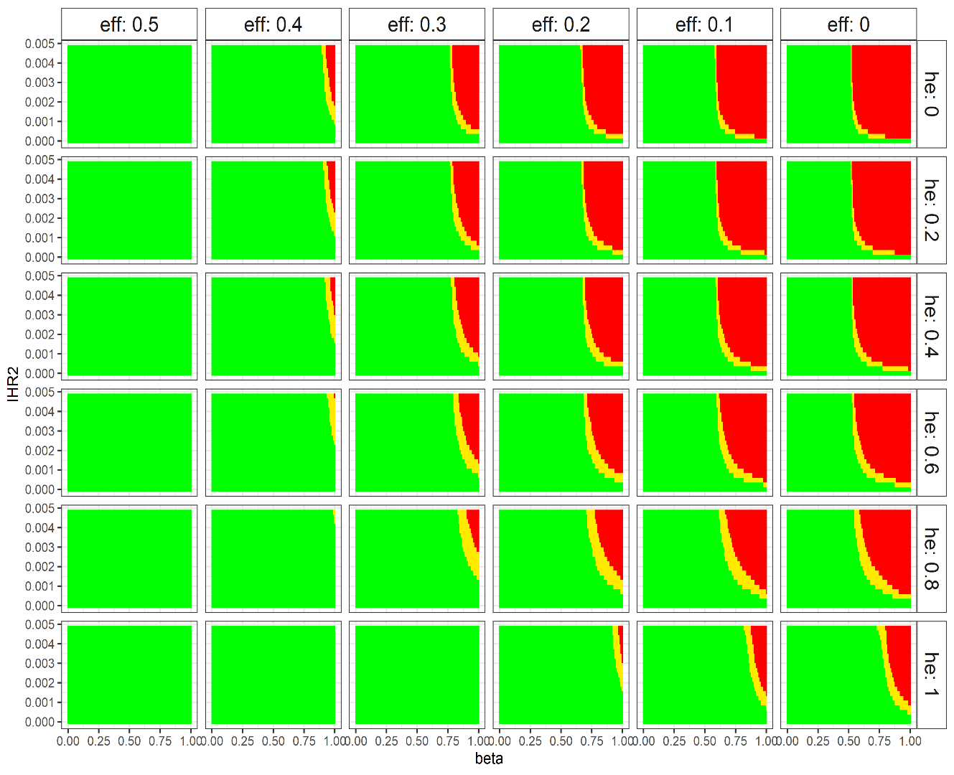
Impact of transmission reduction on peak hospitalisations
Increasing effect of booster on transmission
Impact of booster on transmission rates has big effect (50% reduction enough)
Reducing overall transmission rate has big impact (50% reduction enough)
Small changes in transmission rates can be highly significant
Lower omicron pathogenicity and higher booster protection against hospitalisation have much less impact
= above previous peak
= above 01/12 value
= below current value
Boosters more protective against omicron hospitalisation
Omicron less pathogenic
ILLUSTRATION
ONLY
Decreasing transmission = increasing control effort

Slide 5
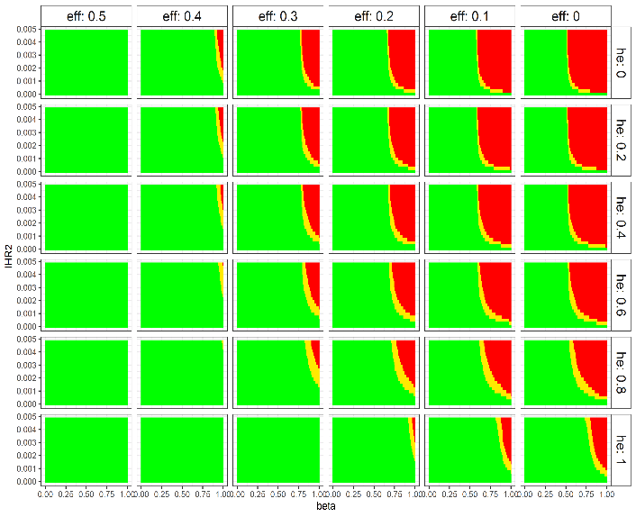
Impact of booster roll-out rate on peak hospitalisations
0.5x CURRENT RATE
CURRENT RATE
2x CURRENT RATE
= above previous peak = above 01/12 value = below current value

Slide 6
Discussion points
There is still huge uncertainty regarding the expected scale and impact of an omicron wave in Scotland/UK – have robust estimates for only 5/18 model parameters
Scenarios presented are not predictions. It is inconceivable that a major omicron wave would not precipitate significant behaviour change plus a government response – both of which would affect the course of the wave
Broad agreement with range of scenarios generated by other models
Note that there remain plausible combinations of parameters that do not generate a major omicron wave (especially if significant impact of booster vaccination on transmission of both variants and/or some cross-protection from exposure to delta)
Baseline scenario generates huge wave of infections which would be enormously disruptive in its own right, given current self-isolation requirements – this can happen even if hospitalisations do not rise dramatically
Large regions of parameter space where interventions to suppress transmission (by 50% or less) are highly effective
Outcome is ‘fragile’: very small changes in parameter values associated with big shifts between favourable and unfavourable outcomes → high uncertainty

Slide 7
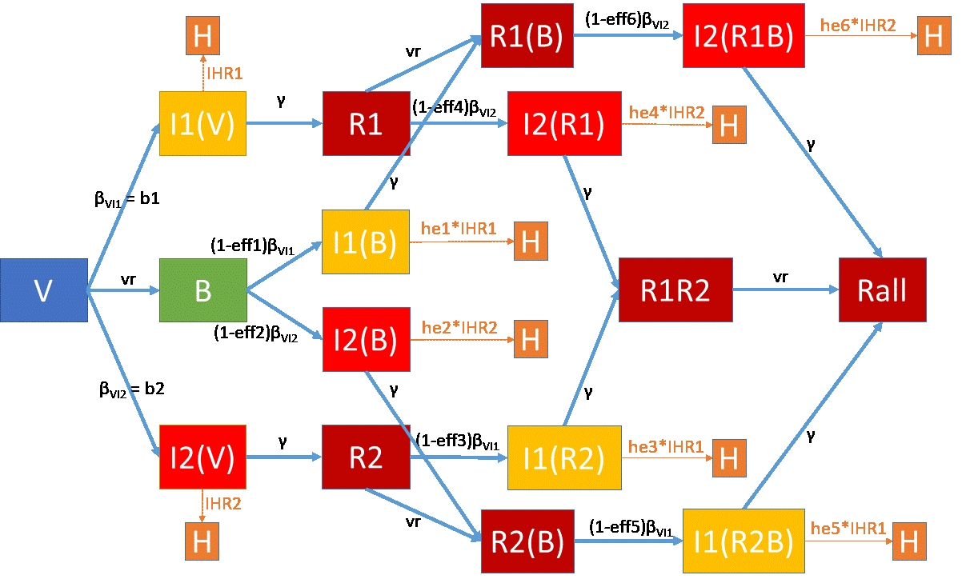
Model structure

Slide 8
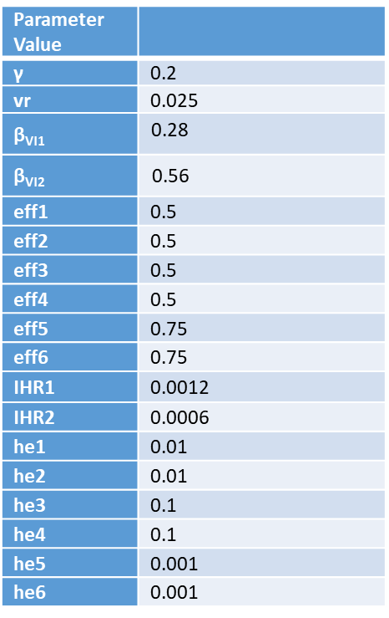
Model inputs
Initial values:
Optimistic parameter values:
Comp | Initial Value
V | (0.455 - 0.01130435 - 1.028696e-05)
B | (0.245-0.008695652 - 7.913043e-06)
I1V | 0.01130435
I2V | 1.028696e-05
I1B | 0.008695652
I2B | 7.913043e-06
R1 | 0.3-0.105
R2 | 0
I2R1 | 0
I1R2 | 0
R1(B) | 0.105
R2(B) | 0
I1R2B | 0
I2R1B | 0
R1R2 | 0
Rall | 0

Slide 9
Model calibration and implementation
TBD

